Slide 1

Chartered Accountancy 101
Notes:
Chartered Accountancy – what is it all about?
Today I intend to answer that exact question and hopefully demystify the profession for you
My name everyone is Sinead Fox-Hamilton. I’m a Chartered Accountant myself and I now work for Chartered Accountants Ireland in a commercial / communications role so today my job is to be your host of this short showcase video which I hope will be fun 101 of Chartered Accountancy – the who, why, what, where, when and how!
Thank you so much for tuning in and let’s get our whistle-stop tour of this career underway….. Let’s chat all things Chartered!

Slide 2

Who is Chartered Accountants Ireland?
Ireland’s largest and longest established professional accounting education & membership body
Dual ‘ACA’ and ‘CPA’ designation - a globally recognised business leadership credential
Educating, supporting, advising – community relationship fostered, a lifelong career partner
Leading voice of the accounting profession and the island’s business community, supporting economic prosperity
All island body with Belfast and Dublin offices – local, accessible
Partner to island’s top employers
39,000 members and 7,000 students
Notes:
Lets now properly introduce Chartered Accountants Ireland also known affectionately as ‘The Institute’
We are
Ireland’s leading, largest and longest established professional accounting education & membership body – we have 7000 students in training and 39,000 qualified members and counting. In the most simplistic of terms – we are like a professional school – you study with us to become a Chartered Accountant but you don’t just get the certificate and go off into the sunset you then become a career long member of our institution.
When you qualify through our Chartered Accountancy programme you are awarded the prestigious ‘ACA’ designation (fun fact - this stands for Associate Chartered Accountant)
Those 3 letters after your name are a hallmark of excellence and the accreditation is a globally recognised business leadership credential
Qualifying with Chartered Accountants Ireland allows you to brand yourself as a ‘Chartered Accountant’ – you’re not aware there are various different brands of accountants in the market so be mindful of that. Not all Accountants are Chartered Accountants and the clout and kudos and prestige of our Chartered Accountants Ireland ACA qualification adds serious weight to your CV – it is a widely respected and sought after qualification and held in high regard by employers and the market.
Something else to note – CPA Ireland amalgamated with Chartered Accountants Ireland in 2024 which now means you get the benefit of obtaining a dual designation upon qualifying - you can use the letters ACA and CPA after your name. So that’s an added bonus for your CV!
In terms of Chartered Accountants Ireland role - for those who enter the profession we are there at every step of your career educating, supporting, advising – we become your a lifelong career partner
The body itself is also the leading voice of the accounting profession and the island’s business community – we represent our members voices and advocate for them helping to support economic prosperity
In terms of our presence, we are pretty unique in that we are an all island body with both Belfast and Dublin offices and education offerings – so we are very much local and accessible. Our students and members value that we are on the ground and can actively offer support to our community.

Slide 3

Becoming a Chartered
Accountant.
Your passport to…
Career choice & stability
A connected community
Travel & international work
Best in class professional education
Notes:
Now, lets learn more about the ACA qualification –
There are 4 key themes around why Chartered Accountancy is an excellent career choice
Ultimately becoming a Chartered Accountant is your passport to
Career choice and stability
Travel and international work
A connected community and
Best in class professional education
Lets take each of those in turn and explore them a little further

Slide 4
Career choice & stability
Professional education developing skills to shape you as a:
Business leader
Critical thinker
Decision maker
Problem solver
Trusted advisor
Strategist
Influencer
Work in any sector… practice, business, public, third level
Develop a varied career in traditional and non-traditional roles
Chartered Accountants work at senior levels across so many market
Enjoy job security – 99% Employment
Earn a top salary £€
Business Leadership qualification: 64% work in business, 28% work in practice
Notes:
First up - Career Choice & Stability
Training to become a Chartered Accountant is a professional development journey.
Our ACA programme is so much more than the age-old stigma of number crunching and guess what there is no bean counting involved. While, absolutely, having a numerical aptitude and being finance literate will be important, you sure don’t need to be a maths brainiac – so let's debunk that myth straight away. I’ll get on to the boring myth later!
Chartered Accountancy training essentially focuses on core business skills to shape you as a leader, a decision maker, problem solver, strategist influencer. You become recognised as a trusted advisor.
Because this is a business leadership credential you can work in any sector – practice, business, public, third. Interestingly 64% of our members work outside of practice or accounting firms. There is a myth that the qualification is associated in the main with Practice but the reality is there is lots of options and variety!
While training you do need to be in an accounting or finance related role (in any sector though) - post qualification you may choose to branch out further and indeed we have members working across varied diverse roles – both traditional in nature and also non-traditional………..General management, HR, Operations, Marketing, Sales to name a few.
Our members are working at the highest ranks across the market - Managing Directors, Chief Executives and Business Heads are often Chartered Accountants. Its great to see how the profession can be so varied and flexible.
It’s also a really stable profession – there is always demand for Chartered Accountants, employment rates are excellent. Chartered Accountants are actively sought after by employers – they are recognised as being desirable candidates to hire because the ACA qualification is held in such high regards. Our members are known to be of a certain calibre.
Salaries in the profession are also extremely attractive – the earning potential is an added bonus and you will be set up for a financially secure future.
Having the ACA designation on your CV holds really strong clout and kudos in the market and will allow you to enjoy career of diversity and reward.

Slide 5
Skills
Customer/ public service
Decision making
Critical analysis
Communication
Organisation
Technology
Attention to detail
Leadership
Interpersonal/ team player
Emotional intelligence
Influence
Creativity
Problem solving
Storytelling
Time management
Adaptability
Notes:
In terms of skills – its important to just take a moment to echo the fact that ACA qualification is a business leadership credential and as such the skills are so much broader than the technical focused stereotype often painted. In fact, Chartered Accountants have a broad commercial skillset.
You might be surprised to know that often when I ask employers what skill they would like to see amplified in their Chartered Accountants their response is communication skills! So, we are definitely more than number crunchers!
Developing this rounded leadership skillset is why Chartered Accountants can enjoy such career success and variety.

Slide 6

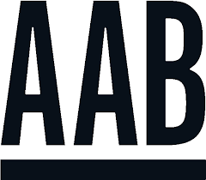


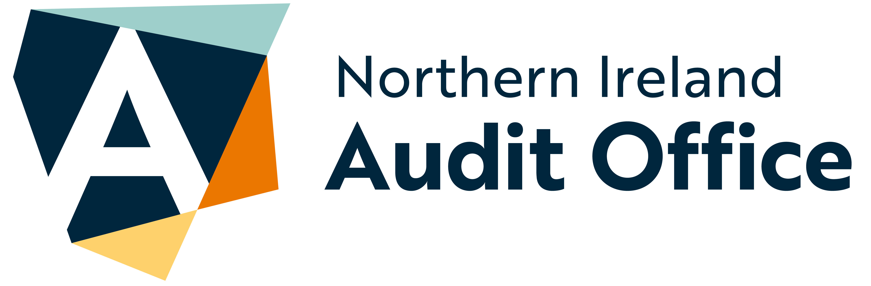


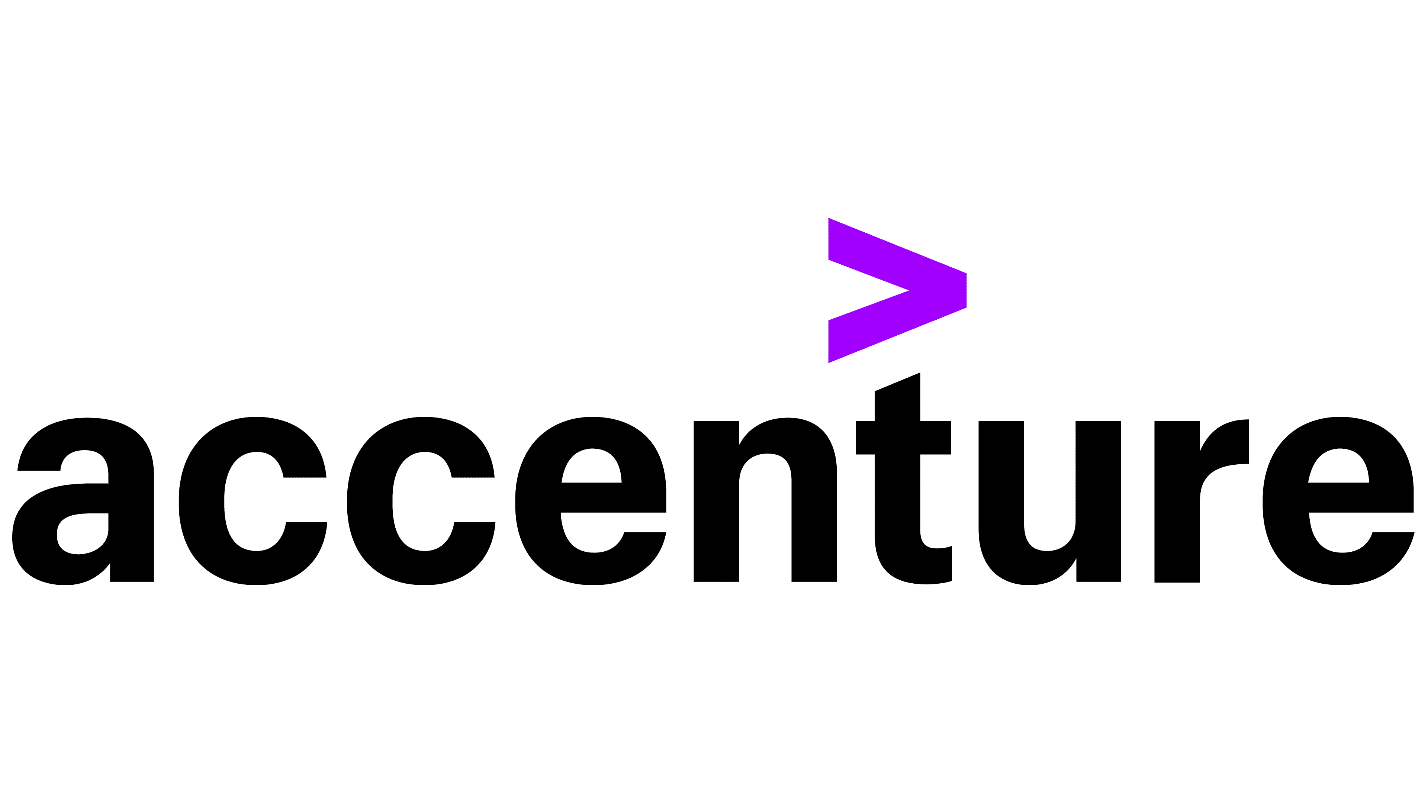
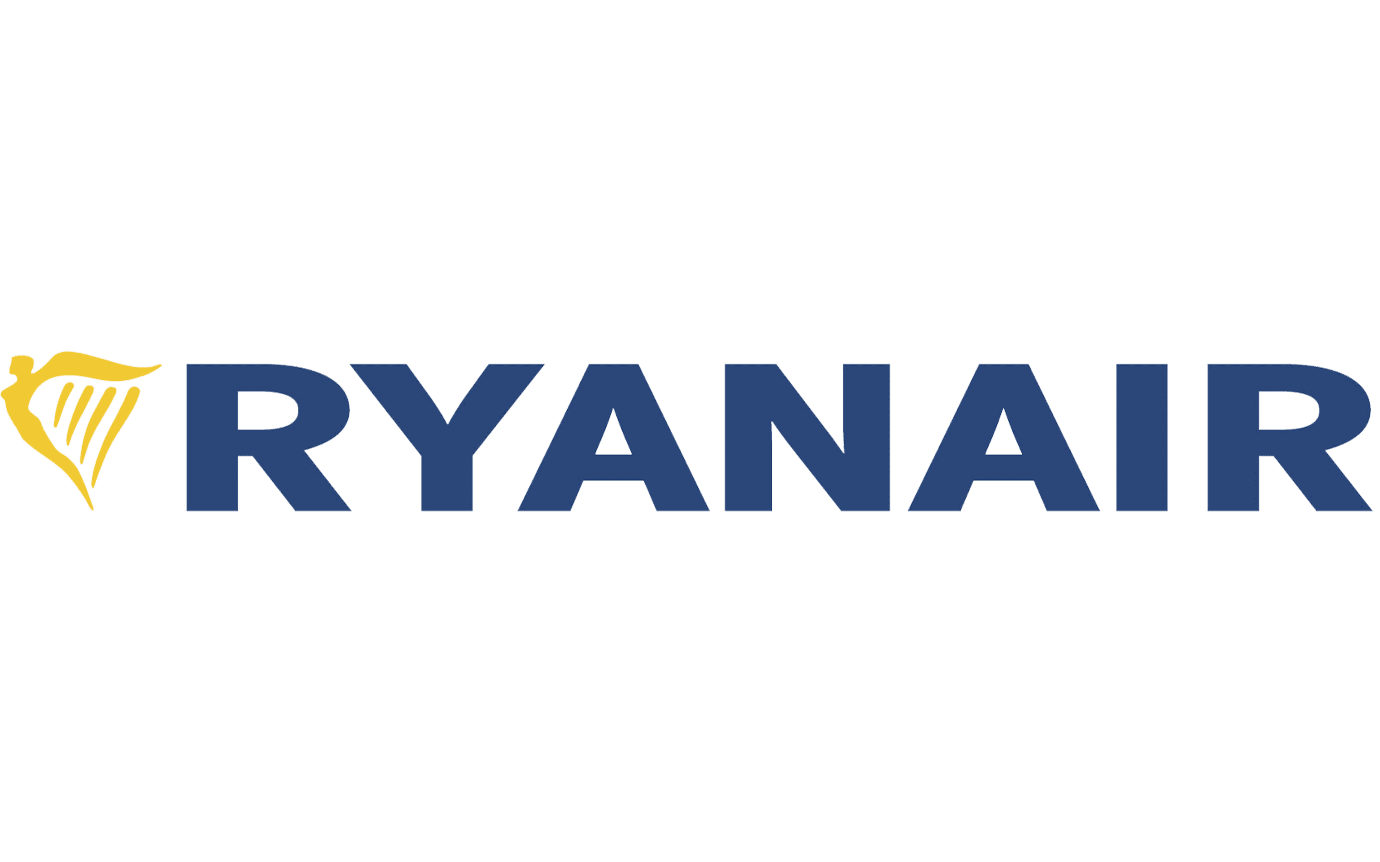











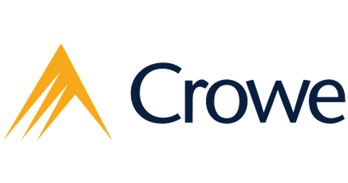


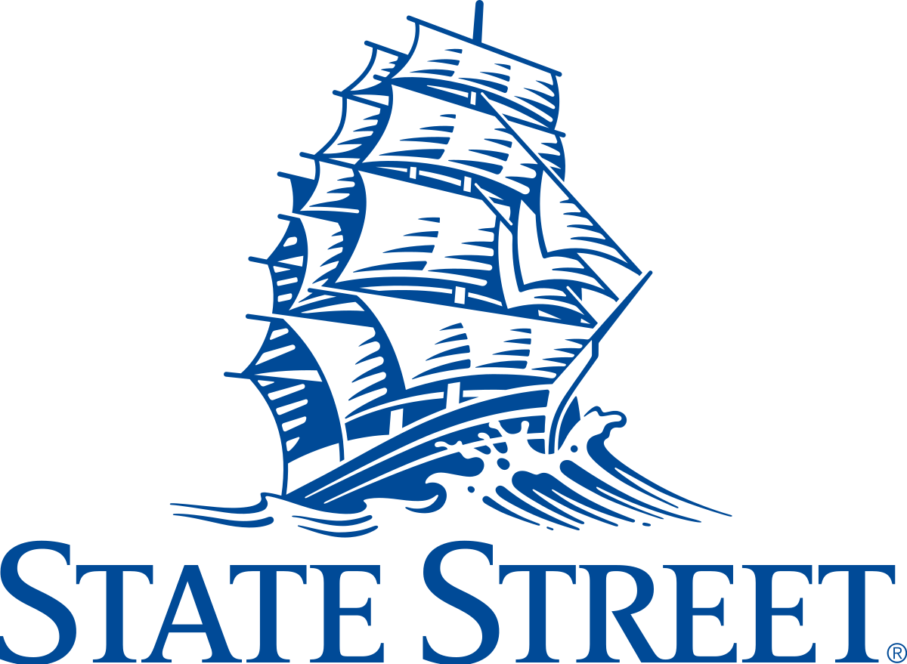

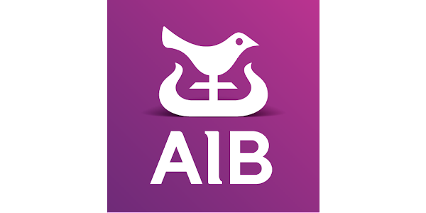

Career choice & stability
PRACTICE
PUBLIC/THIRD SECTOR
BUSINESS
We are partner to leading employers and the island’s largest recruiters of top talent
Notes:
Continuing the Career Choice and Stability theme….
We are partner to leading employers and the islands largest recruiters of top talent.
Our students are training across all sectors, a tiny snapshot of some of our employer partners is displayed. But we couldn’t even begin to try and fit in all of them because we are very privileged and proud to enjoy partnerships with fantastic employers across the market.
I suppose this slide is just to reiterate the point that students can train across all sectors and indeed you will also find our Chartered Accountant members working in varied and diverse roles.
Another myth I can debunk is that it’s a boring profession, my experience is that it's quite the opposite. Personally, I've enjoyed a hugely varied career across practice, business, banking and recruitment before my current role. So I can speak first hand of how the ACA qualification is a passport to a career of choice!

Slide 7
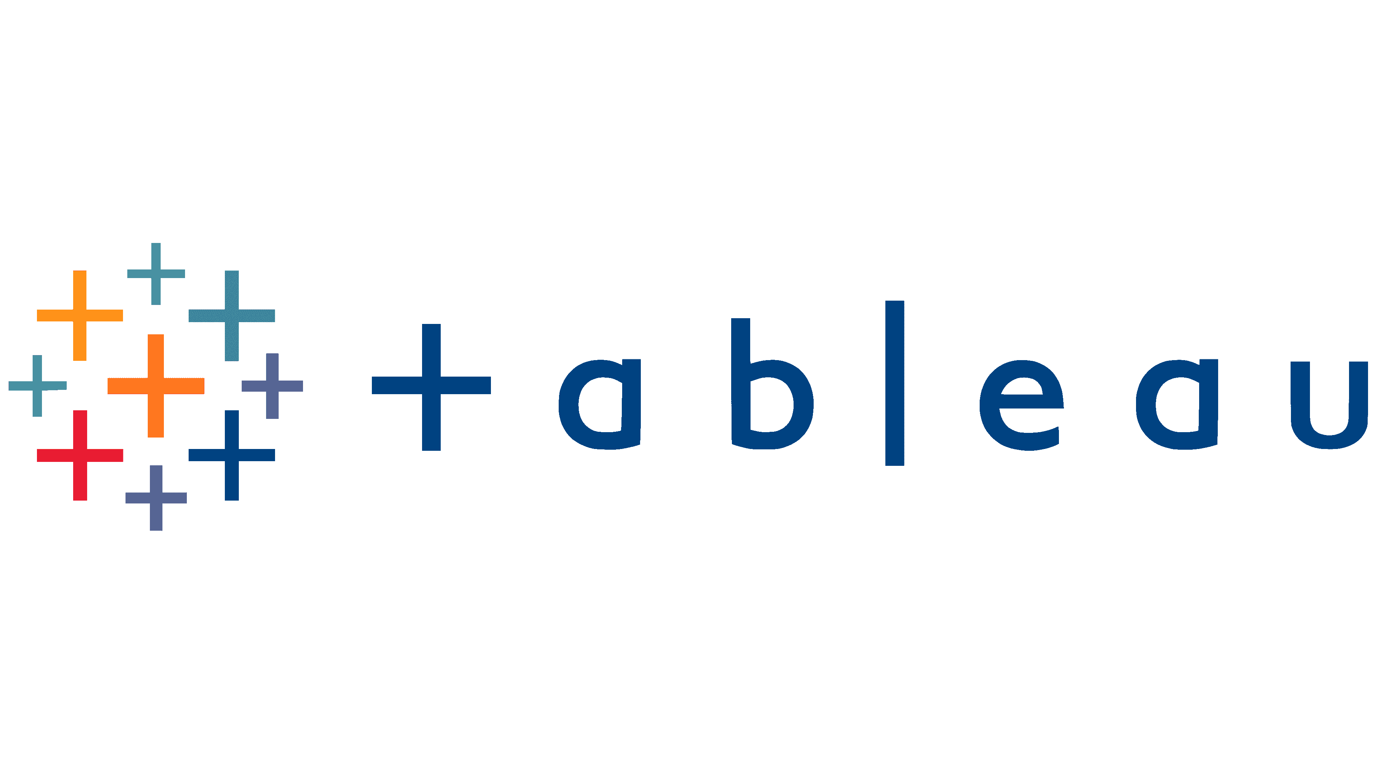


Best in class professional education
Varied programme pathways and options including digital delivery, on demand learning & online exams
Quality
in-house
education
83% qualify faster
Dedicated
student supports
Fewer exams
Emerging tech: AI, RPA, data analytics, sustainability
Modern syllabus - future proofing
your career
Best pass rates
Adaptive learning
Exclusive technology partnerships:
Notes:
Next, lets touch on our best in class professional education
When you train with Chartered Accountants Ireland you can feel confident you are going to be set up for success with our renown quality education programme. We do not outsource our delivery – all is inhouse so all is well connected, you don’t have to worry about disjointed delivery. That is a key differentiator to other accounting bodies – you are not faced with the daunting task of trying to find a reputable tuition provider. All is wrapped in with our programme so you can feel comfortable you are getting a Chartered standard of quality and students reap the rewards because - We have the best pass rates in the market and significantly so – our rates are typically at the 80%+ level which is excellent for a professional level programme
Our programme and exams are absolutely challenging – they have to be, it’s a professional level qualification and that’s why its so reputable and held in such high regard. But our standard of education is such that it equips students to do well. That’s why 83% qualify faster when they choose Chartered (an independent accounting body regulator provided this stat)
We also pledge to keep our programme up to date and under continuous review. Our syllabus is modern and progressive – future proofing your skill development. Recent content refreshes include weaving in modules on:
Emerging tech – AI, RPA
Data, Analytics
Blockchain
Cryptocurrencies
Sustainability
We have also have partnerships with Alteryx, UiPAth and Tableau so students benefit from practical learning and access to these technologies
We have a state of the art learning management hub and have dedicated supports to assist our students through. Our programme is delivered and examined online making it accessible and convenient for students.
In fact our delivery is market leading and we are trailblazing with innovation – we are using cutting edge technology and embracing adaptive learning to create a more tailored and sophisticated experience for our students who are reaping the rewards from our investment in and committment to best in class professional education.
There are also future lifelong learning options post qualification and continuous professional development offerings.
Chartered Accountants Ireland is well placed to support the skill development of business leaders at all stages of their journeys.

Slide 8


Travel & international work
15 professional bodies - representing over 700,000 members and over 1 million students
Globally recognised & respected professional qualification
Travel the world, 5000 work overseas
99 of 100 Best Global Brands employ Chartered Accountants
Chartered Accountants work in more than 200 countries worldwide
More than 50 of the FTSE 100 have a Chartered Accountant as CFO
Notes:
The next key theme to chat about is travel and international work
The ACA qualification is very much a global passport also, in that it is an internationally recognised professional accreditation.
Chartered Accountants Ireland is part of the Chartered Accountants Worldwide family which is 15 professional bodies coming together around the globe representing over 700,000 members and 1m students
Many of our members chose to travel with the qualification and about 5000 Irish Chartered Accountants work overseas and in fact are in hot demand! The Irish qualified Chartered Accountants are sought after by international employers!
Popular destination hotspots include USA, Canada, Australia, New Zealand, Singapore, Dubai to name a few. The warmer and dryer climates are definitely attractive!
Where there isn’t a home ‘Chartered’ body in a country we tend to have Mutual Recognition Agreements (MRA’s) in place. A notable example is America where we have one with AICPA which is the dominant Accounting body in the States. We have lots of US companies in Ireland now so it's fantastic that our Irish ACA qualification is recognised in America, because its worth noting that not all professional Accounting qualifications are so that’s another reason why many choose Chartered. The same can be said for Canada. In effect, CPA in the States and CPA in Canada although being different bodies are then treated as equivalents to the Irish ACA.
A few other interesting facts of note –
99 of 100 Best Global Brands employ
Chartered Accountants work in more than 200 countries worldwide
More than 50 of the FTSE 100 have a Chartered Accountant as Chief Financial Officer or CFO (but as I said before you are not restricted to Accounting/Finance roles, our members are at senior levels across business areas and sectors)
So if travel is on your vision board – the ACA qualification will absolutely support you.

Slide 9
A connected community
Lifelong career partner:
Leading & largest body - 39,000 members, 6,600 students
All-island presence:
Student & member societies -district and international
Access to exclusive business network & connected community of professionals
Access to exclusive business network & connected community of professionals
Dedicated supports for students & members e.g. Thrive, CA Support, Balance
Special interest groups e.g. Sustainability & D&I
Gender balance:
43% members &
48% students are female
Notes:
Let's move on to talking about our Connected Community
Chartered Accountants Ireland is renowned for its connectedness – we are a closely knit exclusive network of business professionals. By joining our body, you become part of a really supportive community of peers. With 7000 students and 39,000 members you are in great company.
In addition to this, you gain a lifelong career partner in ourselves ‘the Institute’ also. We are committed to engaging with and supporting our students and members on their professional journeys and we have a wide range of service offerings including a dedicated CA Support function which helps with matters of emotional and practical support. We are very invested in helping our students and members in the round. We have special interest groups e.g. Sustainability, D&I and lots community activity.
We also are keen to ensure we remain relevant and stay well connected across our special Chartered community. So in addition to centrally ran activity we also have regional and society activity. We have a strong network of student and member led committees which helps us to keep us accessible and linked in to whats happening within the profession.
Its perhaps worth mentioning our community is diverse and inclusive. Another myth that exists is that it’s an old gents club – not the case at all. Delighted to say it’s a really fresh dynamic profession and the female representation is almost at equilibrium to the males which is fantastic.
It's also a profession that is invested in the public good – that's exactly what our Charter represents. And we are always so proud to see the amazing charity work of our members – both from a fundraising point of view but also in terms of them giving their time and expertise to deserving charities and community groups. Being a Chartered Accountant equips you with a fantastic skill set that allows you to help others and to make a difference. At Chartered Accountants Ireland we are also proud to be sustainability and SDG advocates, and we are working to ensure the profession and sector play an active role in making a positive impact in this space also – we are invested in building a brighter and better future for all.
All of these wonderful things I've mentioned are central to our profession and keep us all busy however we also facilitate a programme of social activity as we recognise the importance of relationship building and opportunities to engage. So from balls, quizzes, sports events, comedy nights, food tours, international trips – we have a wide-ranging agenda with something for everyone. As I mentioned before, we are far from boring and we really like having fun too!
So our rounded approach helps ensure we remain well connected and our students and members thoroughly enjoy the reward and benefits of being part of a professional family. And there is a genuine sense of pride and belonging which is pretty special.

Slide 10

How do I become a Chartered Accountant?
The entry routes and journey overview
Entry
Pathway
Programme
Qualification
Access to exclusive business network & connected community of professionals
Relevant
accounting
experience*
and
Exam success
Pass level 7 degree in
any discipline
ATI exams 1st or 2nd year
Member of another professional
accountancy body
Training
Contract
or
Flexible
Route
Chartered
Accountant (ACA Qualified)
*Work in any sector e.g., Practice, Business, Public Sector, Financial Services, Third Sector.
Exclusive technology partnerships:
Notes:
Hopefully the profession and programme is something you are open to considering
If so, lets touch a little on the practical information points
How do you become a Chartered Accountant?
There are a few minimum prerequisites to gain entry to our programme….
You need to be a degree holder (any subject), holder an Accounting Technician Ireland qualification and indeed you can switch from another body across to us which many do to benefit from the Chartered brand and title.
There are 2 pathways to qualification
The Training Contract
The Flexible Route
And I’ll talk a little bit more about them shortly
The programme itself has 2 core elements – the academic course and the professional development practical training piece. Successfully passing our exams and completing the relevant work experience quorum will enable you to qualify as a Chartered Accountant and enjoy using the ACA designation.

Slide 11
Entry Route 1: Graduate
Related Degrees:
Potential full / part exemptions
Undergrad honours degree (level 8) in:
  Accounting
  Finance
  Business
Postgrad Diploma in Accounting
Masters in Accounting
Non-Related Degrees:
Likely no exemptions
Undergrad degree (level 7/8) in ANY discipline e.g. Law, Engineering, History, Marketing, Psychology, Art, English, Medicine, Computing
All backgrounds welcome
What’s the difference?
How many exams you sit on the Chartered programme
Previous related education history = potential exemptions!
Notes:
Talking a little more about the different entry routes
For those are coming through from 3rd level education – all degree holders are welcome
However, there may be a different in your starting point on our programme depending on what course you have studied because those coming from related areas may benefit from exemptions
Exemptions are basically credits allowing you to bypass some of our subjects because you have already covered the same content in your previous education - if your prior education syllabus matches ours in any area we may grant you an exemption
Full or partial exemptions from level 1 or 2 of our programme are often awarded to those coming from undergrad degree in Accounting, Finance, Business type courses. Also, those from post grad diplomas in Accounting and Masters in accounting.
Once you qualify from your degree you can contact us and we can confirm your position.
All pre accredited courses are listed on our website under the exemptions area – if you don’t see your course listed but you feel you could be eligible for potential exemptions there is an option for you to present us with additional details of your prior studies and we can undertake an assessment and confirm the situation.
We are pretty strict with exemptions and only award them when there is a direct match to our syallbus. We want to set students up for success so we need comfort you have covered the content in our syllabus in its entirety because our programme is a building block model, so it is critical you have all the knowledge. It's also why are pass rates are so strong and the best in the market.
If you come from a non-related degree, it is likely you will start at the beginning of our 3 level programme. I came from law so that’s what I did. We have so many students that come to us from a huge variation of backgrounds and employers often really like hiring a mixed of skillsets. And don’t worry, level 1 of our programme will assume you have no accounting knowledge and will equip you with all the learning and fundamentals needed to progress through the programme successfully.
So we absolutely welcome grads from all backgrounds onboarding with us.

Slide 12
Entry Route 2: Accounting Technicians Ireland (ATI)
Apprenticeship pathway
Most popular with school leavers
Earn while you learn
2 year fixed programme
Work 4 days a week
College 1 day a week
On completion transition onto the Chartered ACA programme
Traditional pathway
Study with ATI for one year and gain a merit* – move onto the Chartered programme
Study with ATI for two years to gain the full Accounting Technician qualification - then move onto the Chartered programme
* GCSE/A Level/Leaving Cert criteria to be met also
Accounting Technicians Ireland are a partner body of Chartered Accountants Ireland
Notes:
If you are coming from an ATI background
You can complete the programme either via the Apprenticeship path or via the Traditional path and then come on to our Chartered programme
With the Apprenticeship pathway you will study with ATI for 2 years in a special fixed programme – its very popular school leaver entry route to our profession
With the traditional pathway the model and journey can just differ.
But ultimately if you complete the 2 year programme in either pathway within the required timeframe and achieve the minimum required results, then there is potential to gain full exemptions from level 1 of the ACA programme aka CAP1
There is the option to jump straight into the ACA programme after year 1 of ATI (subject to criteria being met) but you do forego any ACA exemptions in this scenario.
We are seeing lots of ATI students moving on to ACA which is fantastic – it’s a brilliant next step and they are a partner body to the Institute.

Slide 13
The ACA programme & pathways
Training Contract pathway
Employer led training journey
Education and work experience wrapped into an official training agreement with an employer
Structured and consecutive approach
Often connected to graduate schemes
Flexible Route pathway
Student led training journey
Education and work experience elements don’t need to run concurrently or consecutively
Students can enrol independently
Employers can be involved informally
All students complete the same education programme and exams and undertake the same work experience requirement in both pathways
Access to exclusive business network & connected community of professionals
Education
ACA
Experience
Useful Resource:
Training Contract vs Flexible Route Features Table available on www.BecomeACharteredAccountant.com
(also outlines programme entry requirements)
Notes:
So lets get into the detail of our ACA programme and the Chartered pathways to qualification a little more
As mentioned earlier, the ACA programme is made up of 2 equally important elements – education and experience. You can only qualify on successful completion of both.
You must complete the academic course and pass the associated exams
And you must complete a quorum of professional work experience in a relevant role
We’ll chat more above those in the coming slides
In terms of the qualification pathways – there are 2. The Training Contract and The Flexible Route
Let's take each in turn
The Training Contract key features are:
It is an employer led training journey – students source a Trainee role directly from employers
Both the education and work experience are wrapped into an official training agreement with an employer registered to train (tuition fees are covered and a quota of study leave is offered as part of this)
It is quite a structured training model and students complete the course on a consecutive basis in a set time frame (on average 3.5 years, more on this later)
It is often connected to graduate schemes
The Flexible Route key features are:
It is typically a student led training journey however many employers support in the background – they are just not mandated to be involved like with the Training Contract
And with the Flexible Route independent self funded journeys are also viable
Ultimately students can enrol directly with us on the study programme element
However, many employers do actively offer Flexible Route sponsored and supported roles in full or part – it is the students responsibility source the relevant employment directly from the market
Another differential is with the model as it allows more flexibility in terms of the overall journey completion – you have 8 years to complete the education and work experience elements, and they don’t need be run concurrently and your studies don’t need to run consecutively (you have the ability to breakdown level and take subjects and exams on a piecemeal basis)
With both pathways you complete the exact same programme but having 2 options means you have choice to select one that suits your circumstances or preferences best. A full breakdown of the pathway features is available on our Become A Chartered Acocuntant.com hub.

Slide 14

Education journey
There are 3 levels of the ACA programme
How many levels you need to complete depends on your prior education background
Virtual delivery via learning hub (live webinar timetable & self-directed study)
The academic year for the course delivery runs annually from Autumn – Spring/Summer
There are 2 exam sittings (online) per year - Summer & Autumn/Winter
Notes:
Talking a little bit about the education journey….
There are 3 levels of our ACA academic course and each level is taught over an academic year that is run from Autumn – Spring/Summer, and the associated exams then follow with sittings in Summer and Autumn/Winter
How many levels you have to complete depends on your prior experience and if you have been any granted exemptions
I came from a non-related background having studied Law so I completed all 3 levels and because came through a Training Contract pathway I completed each course level consecutively so year 1 in my job I undertook level 1, year 2 level 2 and year 3 level 3. This will vary depending on your circumstances.
The education or study element is designed to be a bolt on to your job. So you work full time gaining that important professional experience and then you complete the academic course in your own time.
Any live virtual classes are held after hours or at weekends to facilitate this - but don’t worry, its designed to be manageable and there are so many supports available to help students along the way.
We have a fantastic learning hub and best in class tutors and a flexible delivery model that facilitates remote, on demand learning and online examination. The programme is very accessible.

Slide 15
The ACA syllabus / exemptions
CAP 1
CAP 2
FAE
Financial Accounting
Finance
Management Accounting
Taxation I
Law for Accountants
(e-assessment)
Auditing & Assurance
Taxation II
Strategic Finance & Management Accounting
Financial Reporting
1. FAE Core
Integrated case study
(inc content on technologies, AI, data analytics)
2. FAE Elective
Choice of Audit, Tax, Advisory, Financial Services, Public Sector
ATI year 2 - full
Honours (level 8) degrees in accounting, finance, etc with 2.2 grade – full/partial
Post-grad diplomas - full
Masters in Accounting - full
(9 recognised courses)
Honours (level 8) degrees in accounting with 2.1 grade –partial
All students must
complete the FAEs
(no exemptions)
Notes:
Talking a little more about the academic course……
You will see a snapshot here of the 3 levels that I mentioned. CAP1 stands for Chartered Accountancy Proficiency 1, CAP 2 Chartered Accountancy Proficiency 2 and FAE Final Admitting Exams
Within each level there is a number of topics and areas to cover, and you will see the subject names listed
Level 1 and 2 (CAP1 and 2) are the 2 technical focused levels – building skills across all accounting and finance fundamentals – equipping you to work across any area post qualification.
At level 3 (FAE) all is integrated together and this is where your skills as a strategist, problem solver, critical thinker are put to the test because the content is broad and stretches across commercial and business challenges. We weave in all the juicy areas that I mentioned before….. emerging technologies, AI, data etc. At FAE you also have a choice of elective subjects so you can pick from Financial Services, Public Sector, Advisory, Tax and Audit which allows you to deep dive further into an area of particular relevance or interest to you.
On this graphic the bottom boxes give a visual of the potential full/partial exemptions that may be awarded against each level.
At CAP1, you may be eligible to bypass this level in part/full if you are holder of an ATI qualification, a related degree or a post graduate diploma.
At CAP2, you may be eligible to bypass this level in part/full if you have completed a recognised Masters in Accounting or recognised under grad degree courses.
All students must complete the FAE level – no exemptions are awarded. This also applies to members switching across from other bodies.
To check potential exemptions, you will be required to submit an application to our Admissions team with the relevant evidence, and they will confirm what you are awarded. Our exemption checking service is non-obligation and free of charge.

Slide 16
Work experience journey
Students can gain the required professional development experience with any employer where they can
access relevant accounting/finance work and where there is a recognised qualified accountant to act as a mentor
Core Professional Values*
Business
Competencies*
Functional
Competencies
Ethics & professionalism
Objectivity
Managing self & others
Communication
Problem solving
Strategic management
IT awareness
Project management
Stakeholder management
Legal performance
Financial reporting*
Audit & assurance
Taxation
Finance & Management accounting
IT/Systems
4 years for ATI Diploma holders
3.5 years for all Degree holders
3 years for accredited Masters/PgDip holders
Period of required work experience:
Notes:
Moving on now to the Work Experience journey – I will touch on this briefly before finishing up today….
Students can gain the required professional development experience in any place of employment where they can access relevant accounting/finance work and where there is a qualified accountant to act as a mentor / training approver
We provide students with a framework of competencies and ask them to complete an online log or diary (aka Training Development Log) outlining the details of their role and growth over the training period under supervision of a workplace mentor
The graphic shows some of the competencies and values that should be demonstrated
Those marked with an asterisk are mandatory
You will note that under the functional / technical stream financial reporting is the only mandated competency – there is another myth that this qualification is aligned to Audit or Tax but these are not core requirements. If you get exposure to these areas that’s a bonus but it is not essential in our framework
We are very focused on tracking your development as a wider business leader – ensuring you cultivate strong communication, management, technofgloy skills for example. And that you evolve into a trusted values driven professional.
The work experience quorum is dictated by your previous education history:
ATI qualification holders must log 4 years of experience as standard however there is an option to apply for a discount of up to 2 years
For all Degree holders its 3.5 years as standard and it
3 years for accredited Postgraduate Diploma and Masters holders
For those completing the qualification with the Training Contract pathway – the length of the contract with match the work experience quorum
Just to mention there is a prior work experience policy whereby we may be able to reduce the ACA training term if you have completed relevant work experience after the point of eligibility of entry to the programme e.g. after completion of your degree. Get in touch to learn more.
When your log is complete, this is reviewed and signed off by your in-workplace approver / mentor to ensure it’s a true and fair representation of the work undertaken. It is then submitted to us for final assessment.
Assuming all is in order, we approve it and as long as you have all your exams completed successfully, we can then admit you to membership and award you those prestigious 3 letters ACA – and you can use the exclusive title of Chartered Accountant. You will get to attend a fabulous conferral graduation ceremony with us and celebrate your achievement - Job done! Then you can go onto enjoy the benefits of membership and of course there are further study options should you be a keen learner.
But today was all about demystifying the Chartered Accountancy profession and qualification routes. So, I hope my presentation has done just that.

Slide 17
Securing ACA sponsored roles and tips
Larger employer partners typically release their graduate ACA roles in Autumn annually
Larger employer partners internships and placement opportunities go live pre/post Christmas – can lead to training role
Other employers recruit all the year round
ACA programme can be bolted on to any Accounting/Finance role – it doesn’t have to be a ‘Training Contract’ or ‘Trainee Chartered Accountant’ role
Keep eye on employer websites and social media pages, standard job forums and Chartered Accountants Ireland website Training Vacancy page and Instagram account
Internships / placements / work experience are a great way to get exposure to roles and often can lead to graduate job offers
Go to careers fairs and engage with employers – ask questions about roles, culture etc
Notes:
In terms of a few wrap up tips on securing sponsored roles….
Typically, large employers with established graduate schemes will recruit in Autumn / Winter time for roles commencing the following Autumn
However, lots of employers will recruit throughout the year so it’s important to keep an eye on the market – follow websites, social media sites, job boards etc
Placements and internships are also a really good way to get experience, and many will lead to job offers for grad roles
However its important to remember you can get your relevant ACA work experience in any accounting / finance role in any sector that gives you exposure to the competencies discussed earlier – its doesn't have to be a brand training role (nor does it have to be sponsored)
Another tip - I would encourage you to engage with careers services available to you and attend careers events – the more information you get the better
You can also engage with us at Chartered Accountants Ireland – while we don’t get involved in the employment aspect, we do have a training vacancy listing on our website which some employers choose to use – it is not representative of all live opportunities as many employers have their own processes and mechanisms so don’t need to use our platform. We do also have listing of training organisations and I would encourage you to proactively reach out to employers of interest with your CV and details. And we showcase careers content on our careers Instagram page also.
All aspects of employment / recruitment are between student and employer.
I hope this is helpful.

Slide 18






Chartered Accountancy overview
  Most prestigious
  Best education offering
  Fastest to qualify
  Fewer exams
  Highest pass rates
  Largest & connected network
  Global recognition
  High earning potential
  Job security
  Unrivalled & local support
ACA is your passport to a career of choice –
develop as a business leader & work in any sector
Notes:
Before I leave you, lets very quickly recap on some of the main differentiators of the Chartered Accountants Ireland qualification:
Our ACA accreditation is considered the most prestigious professional accounting and business leadership credential in the market
It is globally recognised
And the Chartered community is the largest and most connected exclusive professional network
The body is all island with physical presence in Belfast and Dublin, so we are very much local and accessible
We are on hand to support students and members
In terms of our education, it is best in class and inhouse, we do not rely on 3rd parties
We also have the best pass rates in the market, significantly so
Students will also qualify faster via the Chartered path vs others
Chartered Accountants are in constant demand so as such there is strong job security
And there is top earning potential within the sector also which makes it an attractive choice
So that is a whistle-stop tour of the highlights of my talk
If I can leave you with one key takeaway – its that Chartered Accountancy is a passport to a career of choice across sectors – you will develop as a trusted business leader and enjoy a career of recognition and reward.

Slide 19

Find out more
For more on how you can
become a Chartered Accountant:
Instagram: @CharteredAccIrl_Careers
Email: info@charteredaccountants.ie
Phone: 0818 28 29 28
Website: becomeacharteredaccountant.com
Notes:
Thank you for listening and if you would like to find out more……
Please check out our careers hub at -
www.becomeacharteredaccountant.com
You can also contact us at:
info@charteredaccountants.ie
For all the latest updates - please also follow our careers page on Instagram
Thanks again for joining me and I hope we get the opportunity to welcome you into the Chartered community in the future. Take care.

